Slide 1


CMR TECHNICAL CAMPUS UGC AUTONOMOUS Accredited by NBA & NAAC with ‘A’ Grade Approved by AICTE, New Delhi and JNTU, Hyderabad Kandlakoya(V), Medchal Road, Hyderabad-501401, Telangana Department of Computer Science and Engineering Phishing Detection System Through Hybrid Machine Learning Based on URL
BATCH NO : 07
P.Rahul Yadav 217R1A0542
S.Sai Charan 217R1A0549
T.Saketh 217R1A0561
Under the Guidance of
N.BHASKAR
(Associate Professor)

Slide 2
Introduction
Existing system
Disadvantages of existing system
Proposed system
Advantages of proposed system
Hardware and software requirements
Novelty
Architecture
Modules
UML Diagrams
Sample code
Results
Conclusion
Future Scope
References
Github Link
CONTENTS

Slide 3
INTRODUCTION
Phishing is a cybercrime where attackers create fake websites to steal personal information like passwords. As the internet grows, it brings benefits but also increases the risk of cybercrime. This project focuses on detecting phishing websites using machine learning by analyzing URL structures. A dataset of over 11,000 phishing URLs is used, and models like decision tree, naive Bayes, random forest, and others are applied. A hybrid model (LSD) combining logistic regression, support vector classifier, and decision tree improves accuracy with soft and hard voting methods. Cross-fold validation and grid search are used to optimize results, with metrics like accuracy, precision, and F1-score evaluating performance. The goal is to create a more effective phishing detection system than existing models.

Slide 4
existing system
Phishing detection systems often use two main approaches: whitelist-based and blacklist-based. Whitelist-based systems allow trusted websites but may give false alarms for new legitimate sites, while blacklist-based systems block known phishing sites but struggle with new attacks. Machine learning techniques have been applied to improve detection, with some systems achieving up to 99% accuracy by analyzing features like URLs and email content. Advanced methods, like CANTINA and Phish-WHO, use keyword extraction and domain matching to detect phishing sites. While whitelist and blacklist systems have limitations, machine learning offers a better way to identify hidden or first-time attacks. This project aims to enhance phishing detection with a hybrid machine learning model using URL features.

Slide 5
DisadvantageS of Existing System
The Complexity of Data
Existing machine learning models often struggle to handle large and complicated datasets. Phishing URLs have many variables, and if the model can't manage this complexity, it may fail to detect phishing attempts effectively.
Data Availability
Machine learning models rely on large datasets to make accurate predictions. If there isn’t enough data to train the model, it might not perform well and could miss detecting phishing URLs.
Incorrect Labeling
The accuracy of machine learning models depends on the quality of the labeled data used for training. If the training data is labeled incorrectly (e.g., marking a phishing URL as safe), the model will learn incorrect patterns and may give inaccurate results.

Slide 6
Proposed system
This study proposes a phishing URL detection system using 11,000+ phishing URL attributes to classify threats. Various machine learning models like Decision Tree (DT), Linear Regression (LR), Naïve Bayes (NB), Random Forest (RF), Gradient Boosting Machine (GBM), Support Vector Classifier (SVC), and K-Neighbors Classifier (KNN) are applied. A hybrid model (LSD: LR+SVC+DT) with soft and hard voting improves accuracy. Cross-fold validation and canopy feature selection enhance predictions. The model is evaluated using accuracy, precision, recall, specificity, and F1-score. This approach ensures robust phishing detection by optimizing ML techniques for better cybersecurity.

Slide 7
Advantages of proposed system
Enhanced Security Against Phishing Attacks
Phishing URL classification was done using machine learning to help fight the growing threat of cybercrimes, where attackers use fake URLs to steal sensitive information. A phishing dataset was used in the experiments to prevent security breaches.
Effective Data Handling and Advanced Model Integration
Before applying the algorithms, the dataset was cleaned by removing any missing values. Various machine learning models, such as Decision Tree, Naive Bayes, and Random Forest, were used. Additionally, a hybrid model (LSD), which combines Logistic Regression, Support Vector Classifier, and Decision Tree, was applied to classify phishing URLs based on important features. This approach helps detect phishing attacks more effectively.

Slide 8

Requirements specification
Hardware requirements :
➢ Processor - Pentium –IV
➢ RAM - 4 GB (min)
➢ Hard Disk - 20 GB
➢ Monitor - SVGA

Slide 9

Requirements specification
Software requirements :
Operating system : Windows 7 Ultimate.
Coding Language : Python.
Front-End : Python.
Back-End : Django-ORM
Designing : Html, css, javascript.
Data Base : MySQL (WAMP Server).

Slide 10

NOVELTY
The novelty of this project lies in its use of a hybrid model (LSD) that combines Logistic Regression, Support Vector Classifier, and Decision Tree with soft and hard voting mechanisms. This approach improves accuracy and overcomes the limitations of individual models. The project uses a large dataset of over 11,000 phishing URL attributes to classify phishing websites more effectively. It also employs grid search for parameter tuning, cross-fold validation, and the canopy feature selection technique to optimize performance, making it more precise and reliable than traditional methods. This creates a more secure, scalable solution for detecting phishing attacks.

Slide 11
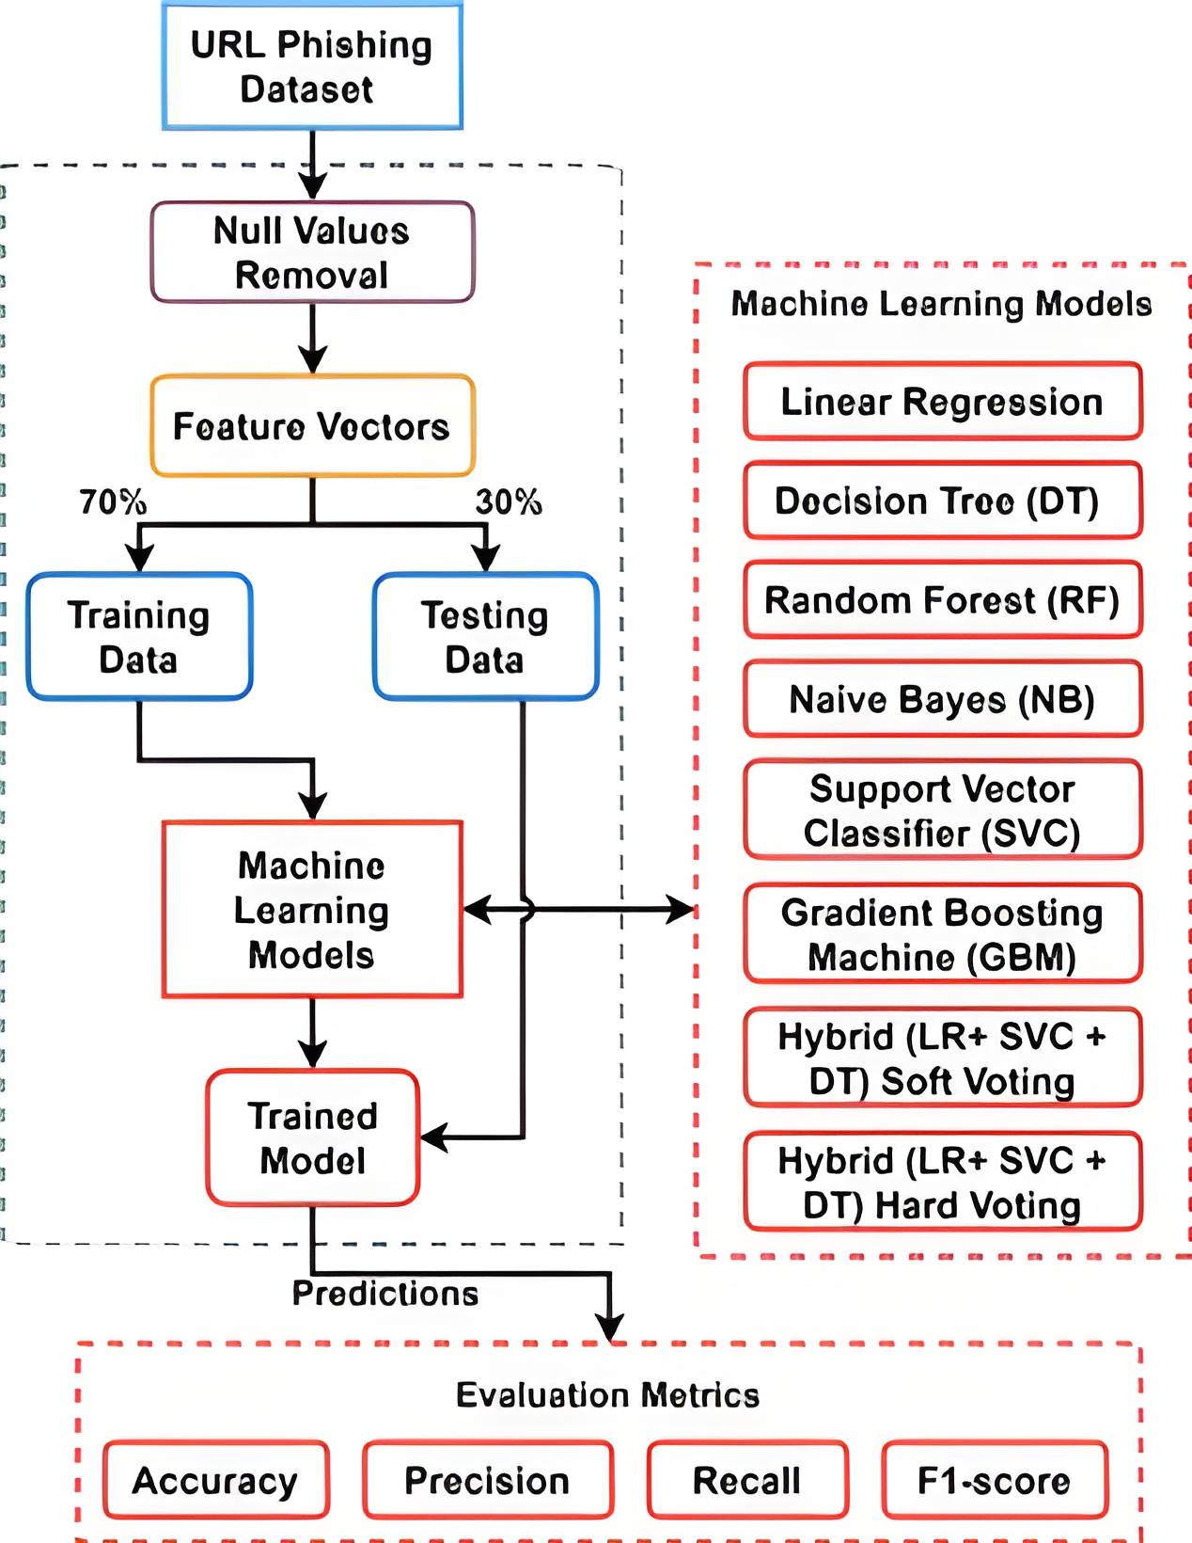
ARCHITECTURE

Slide 12
MODULES
Service Provider
The service provider logs in using valid credentials and performs operations like browsing, training, and testing URL datasets. They can view accuracy results in charts, predict URL types, and download predicted datasets. Additionally, they can monitor remote users and manage user access.
View and Authorize Users
The admin views registered users along with their details like username, email, and address. They have the authority to approve or deny user access based on registration details.
Remote User
Users register and log in before performing any operations. Once logged in, they can predict URL types and view their profile information. Their registration details are stored in the database for verification and authorization.

Slide 13
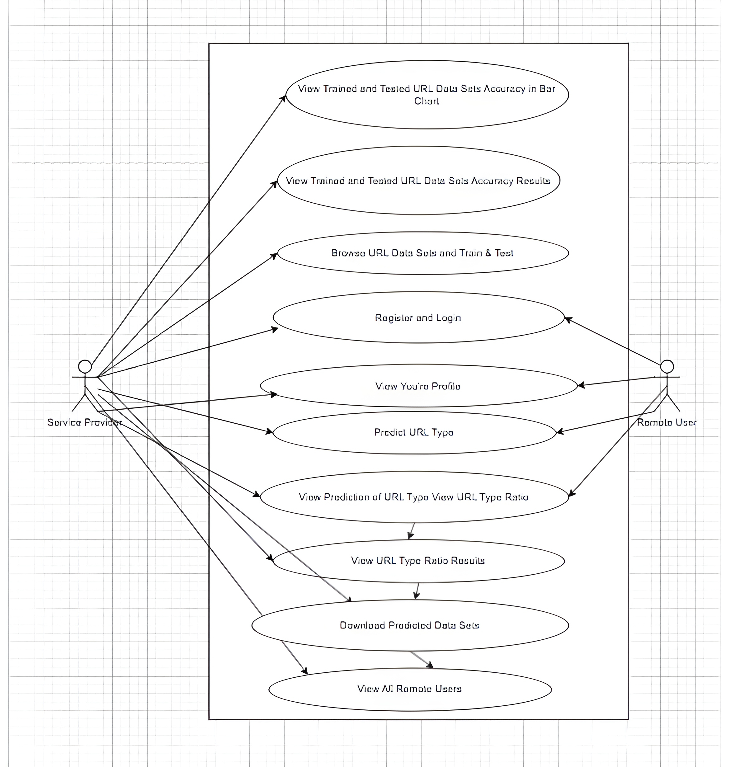
UML DIAGRAMS
Use Case Diagram

Slide 14
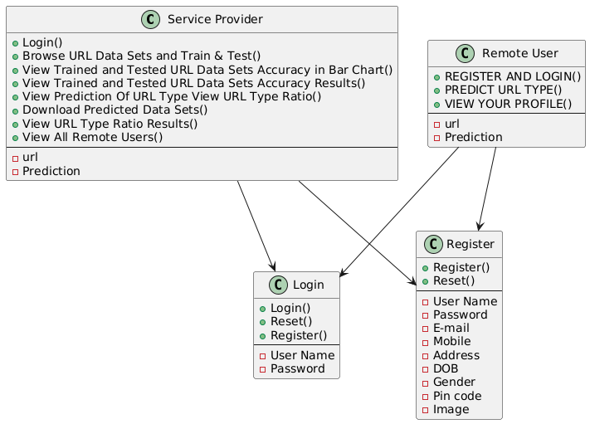
UML DIAGRAMS
Class Diagram

Slide 15
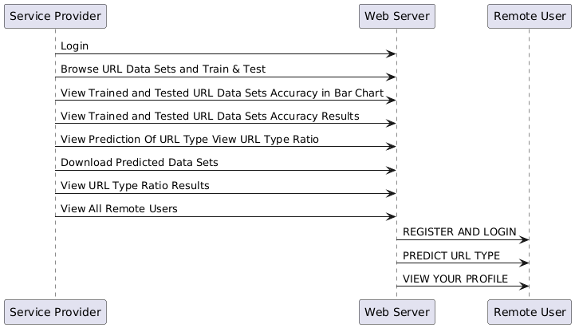
UML DIAGRAMS
Sequence Diagram

Slide 16
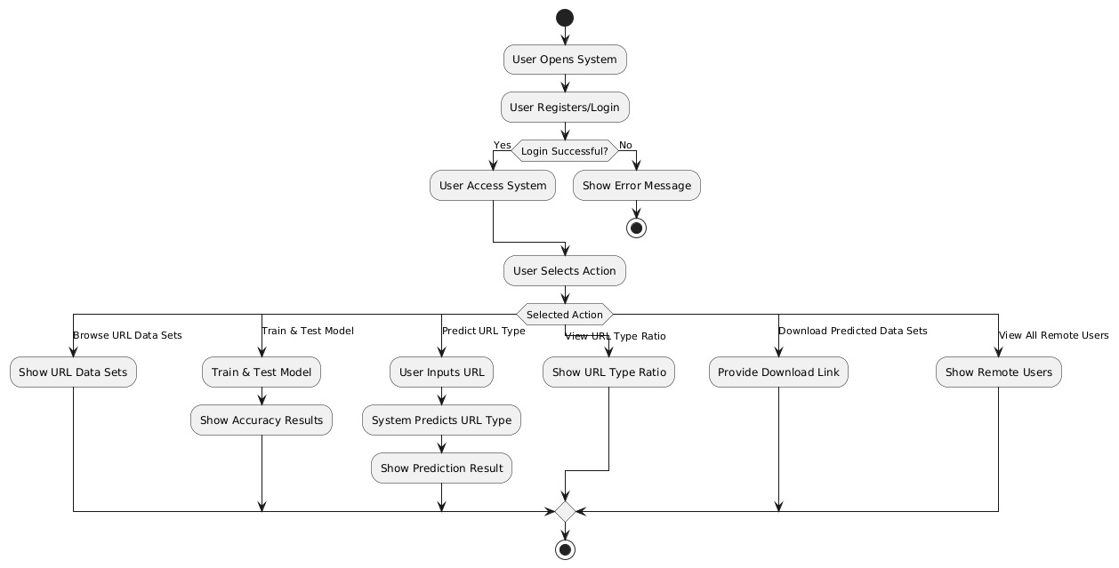
UML DIAGRAMS
Activity Diagram

Slide 17
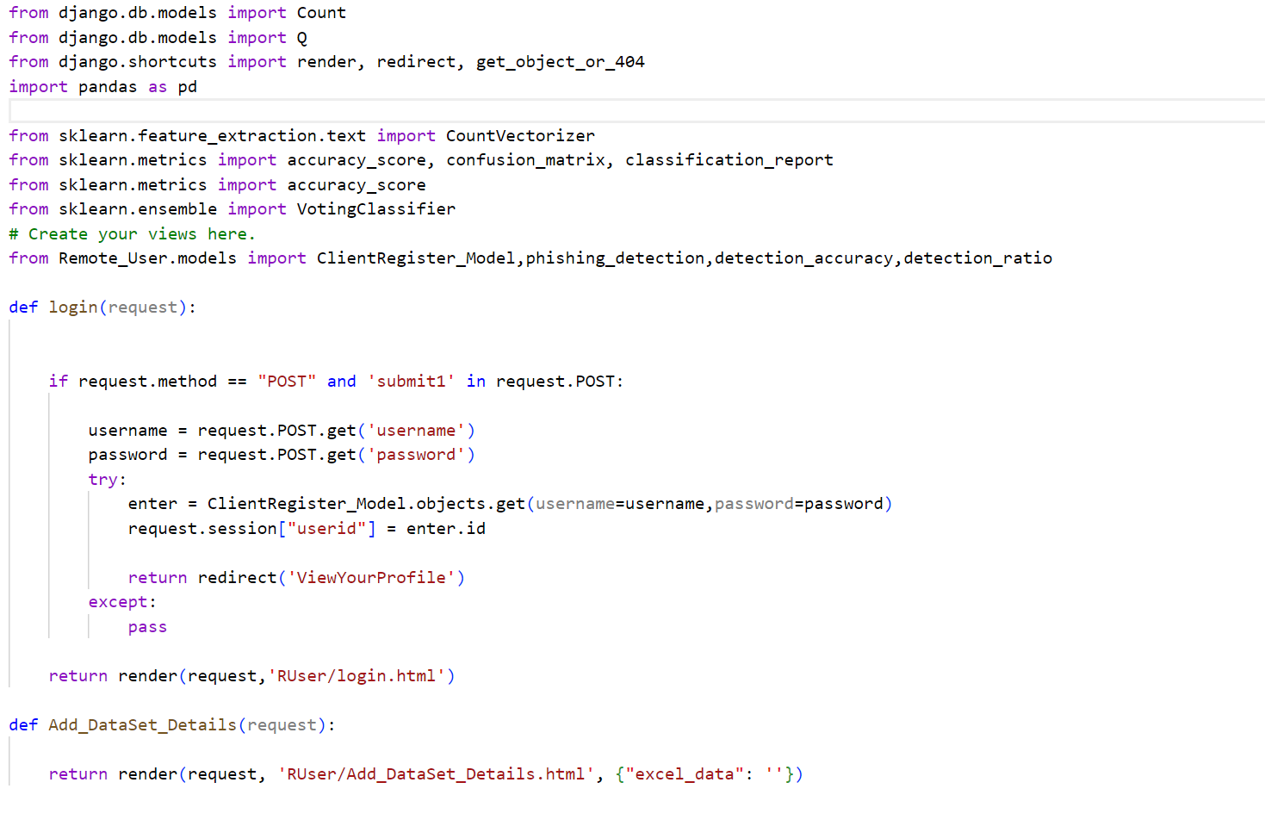
SAMPLE CODE

Slide 18
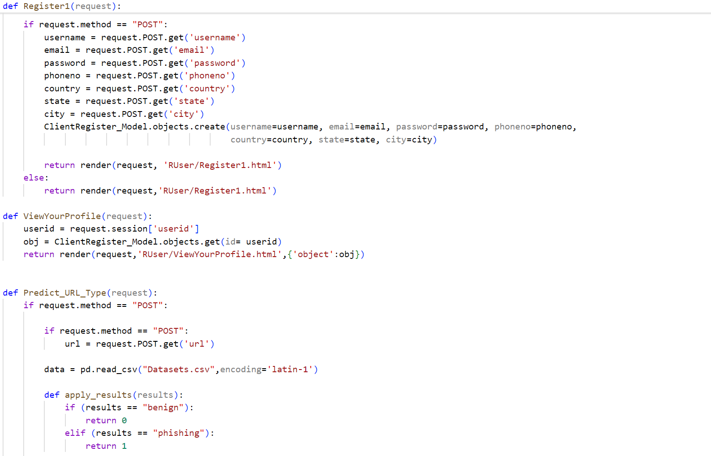
SAMPLE CODE

Slide 19
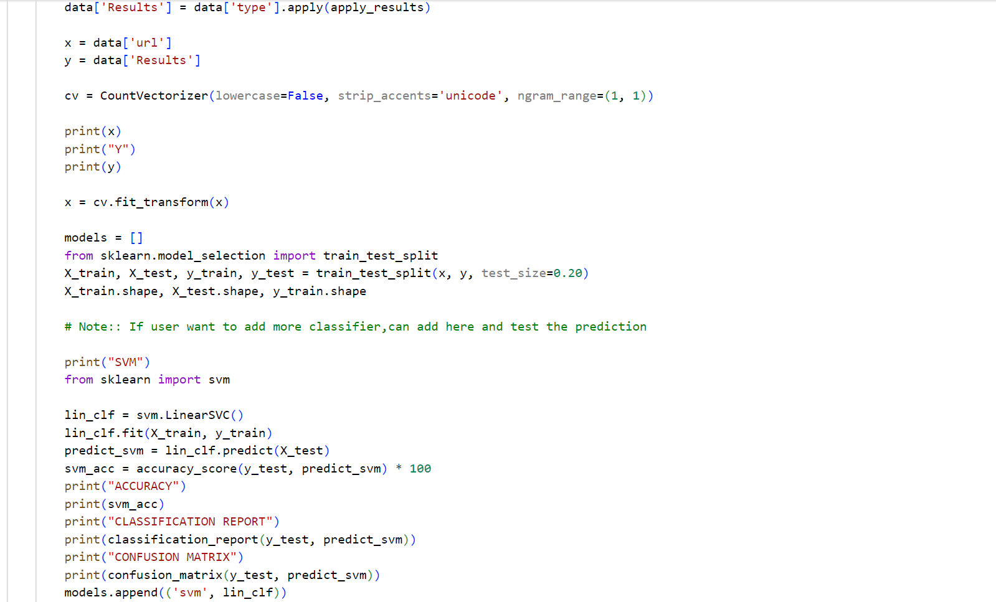
SAMPLE CODE

Slide 20
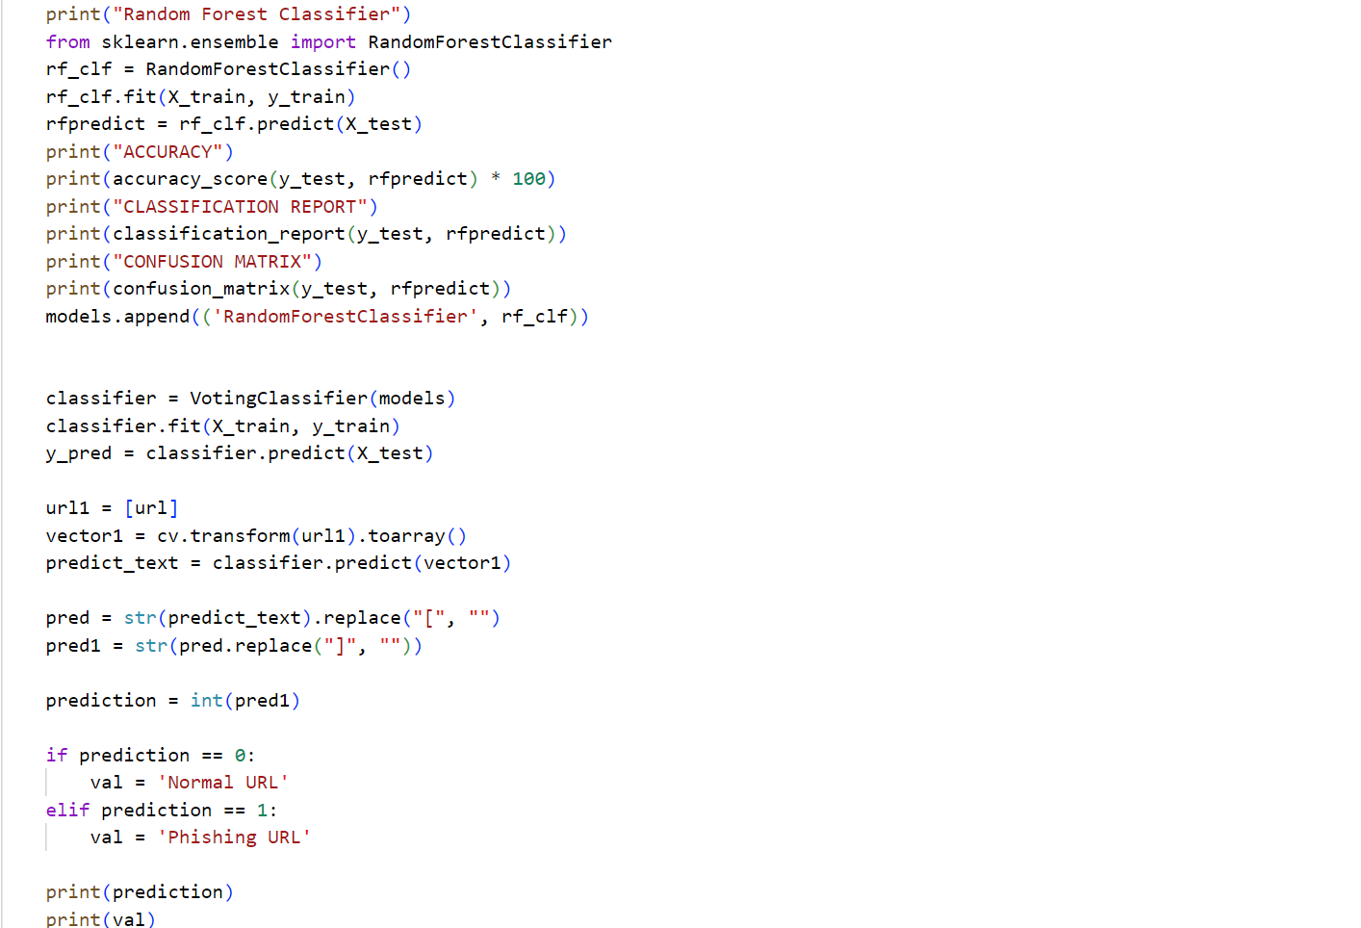
SAMPLE CODE

Slide 21
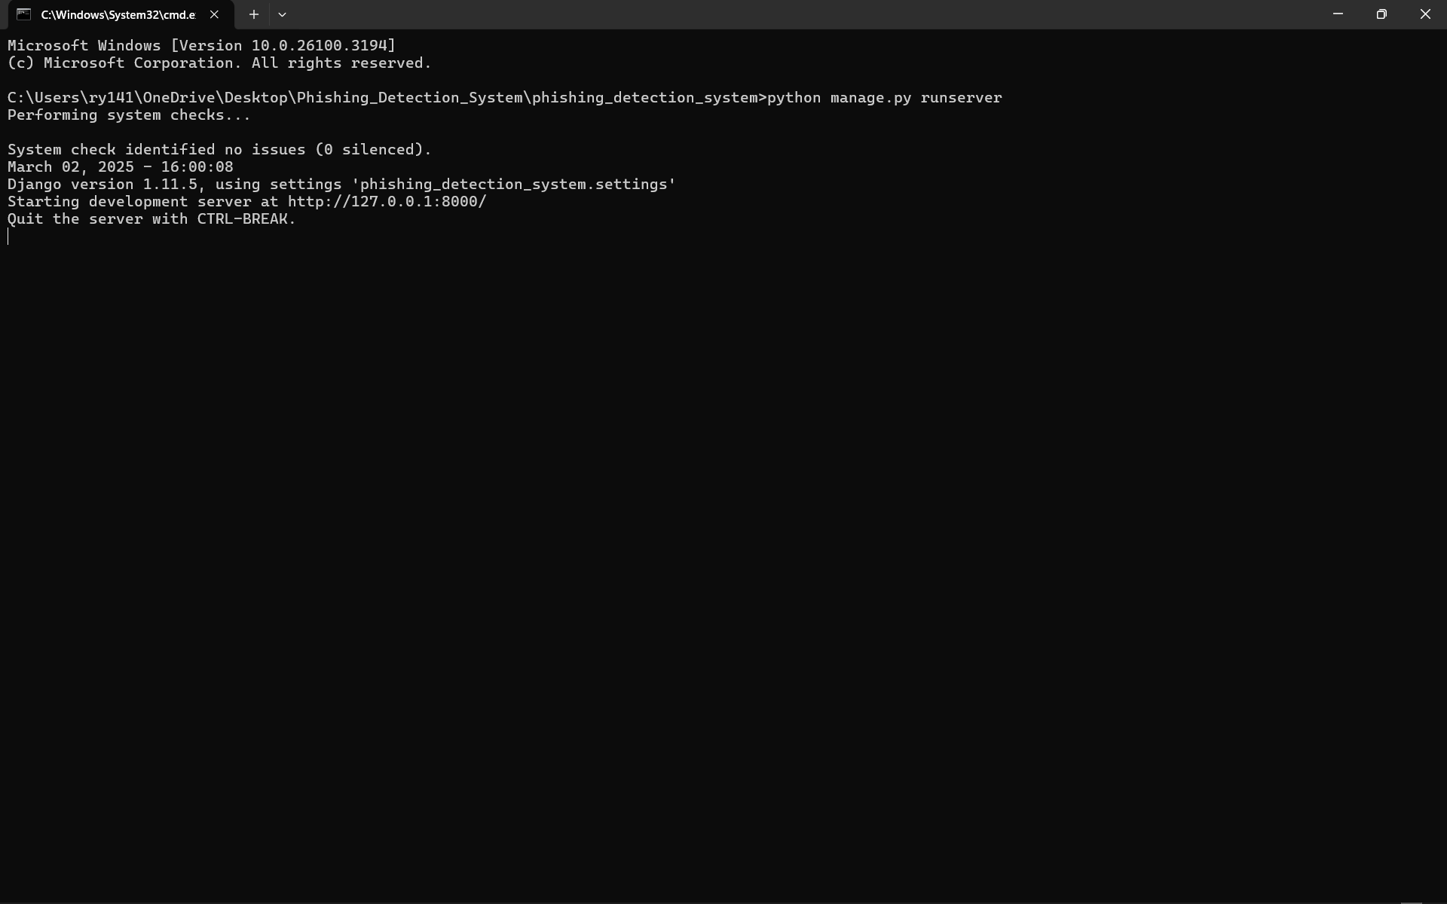
RESULTS

Slide 22
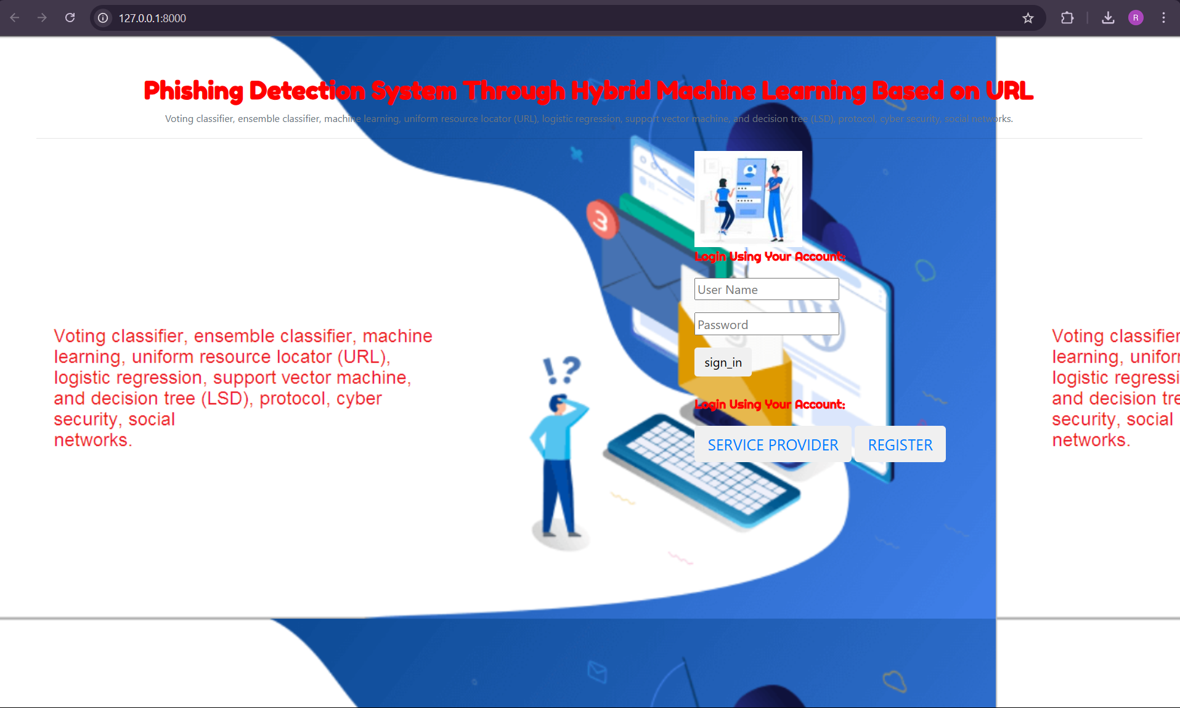
RESULTS

Slide 23

RESULTS

Slide 24
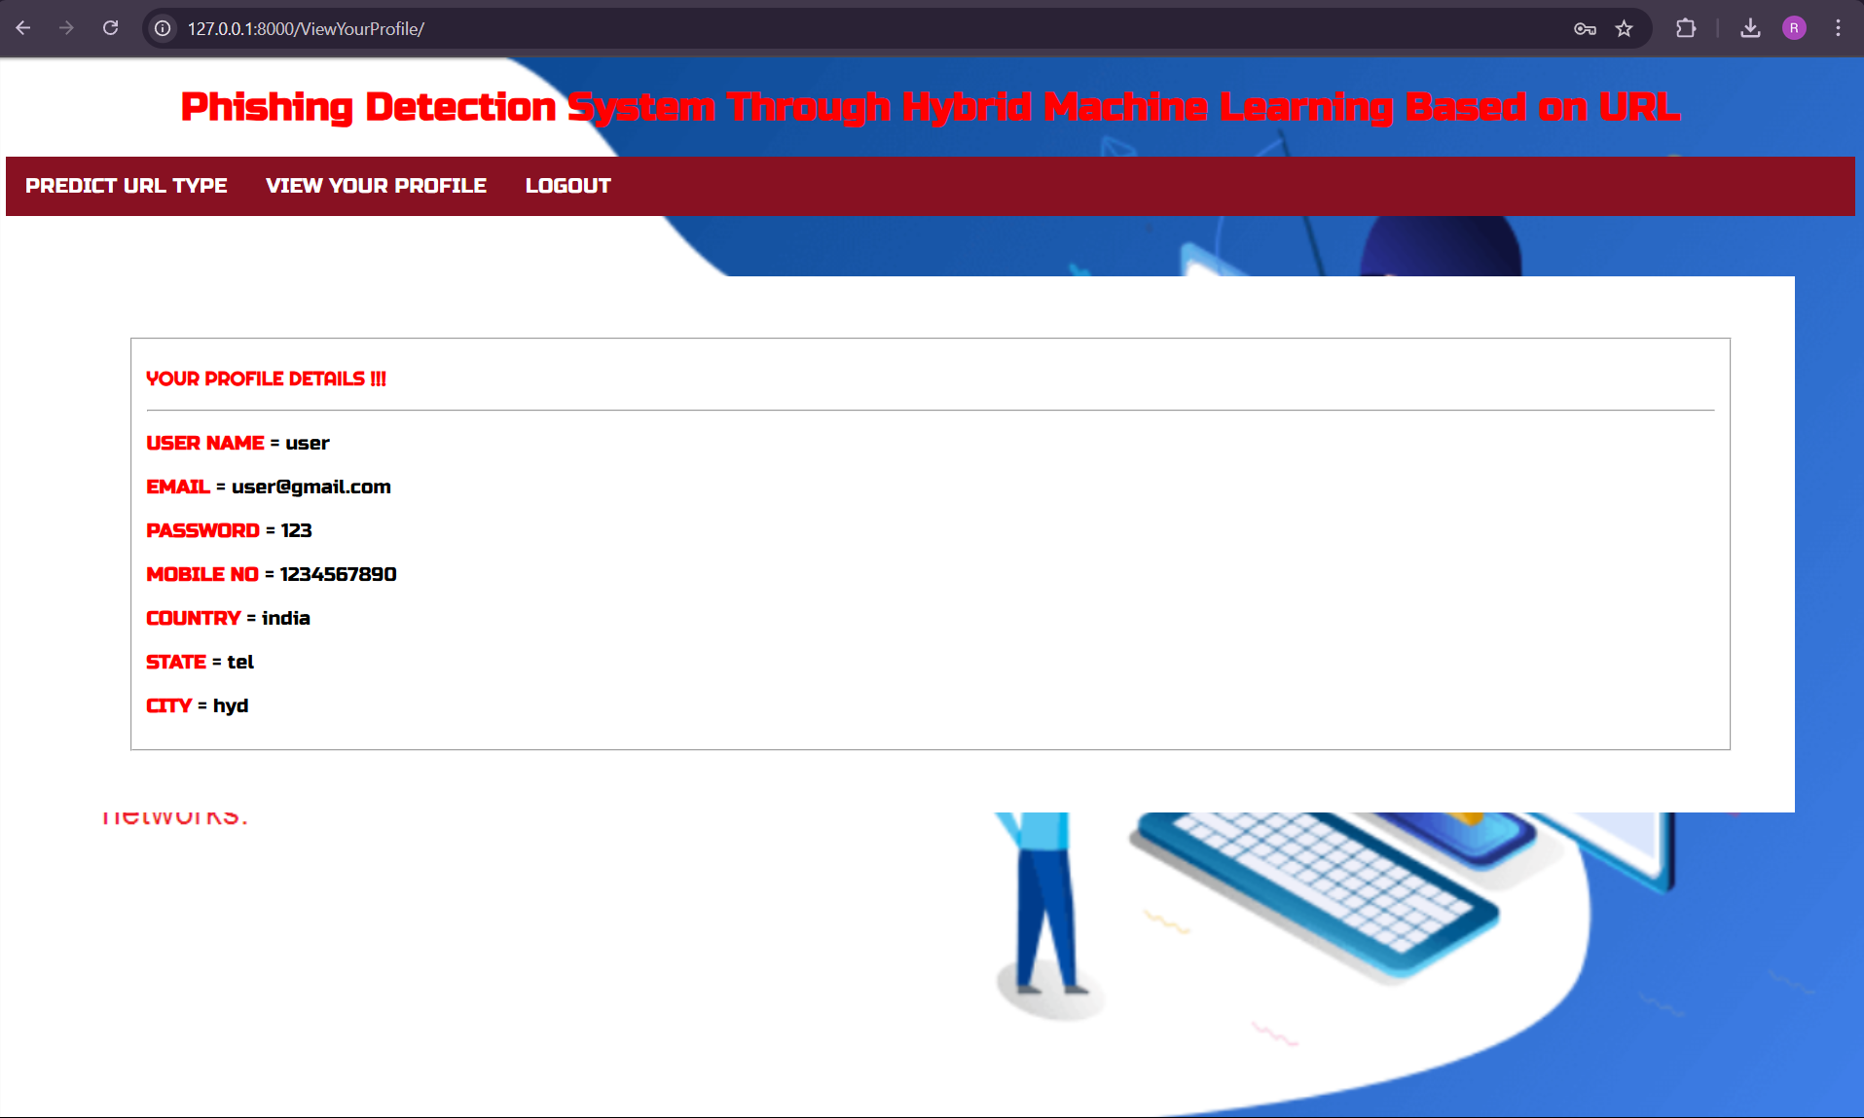
RESULTS

Slide 25
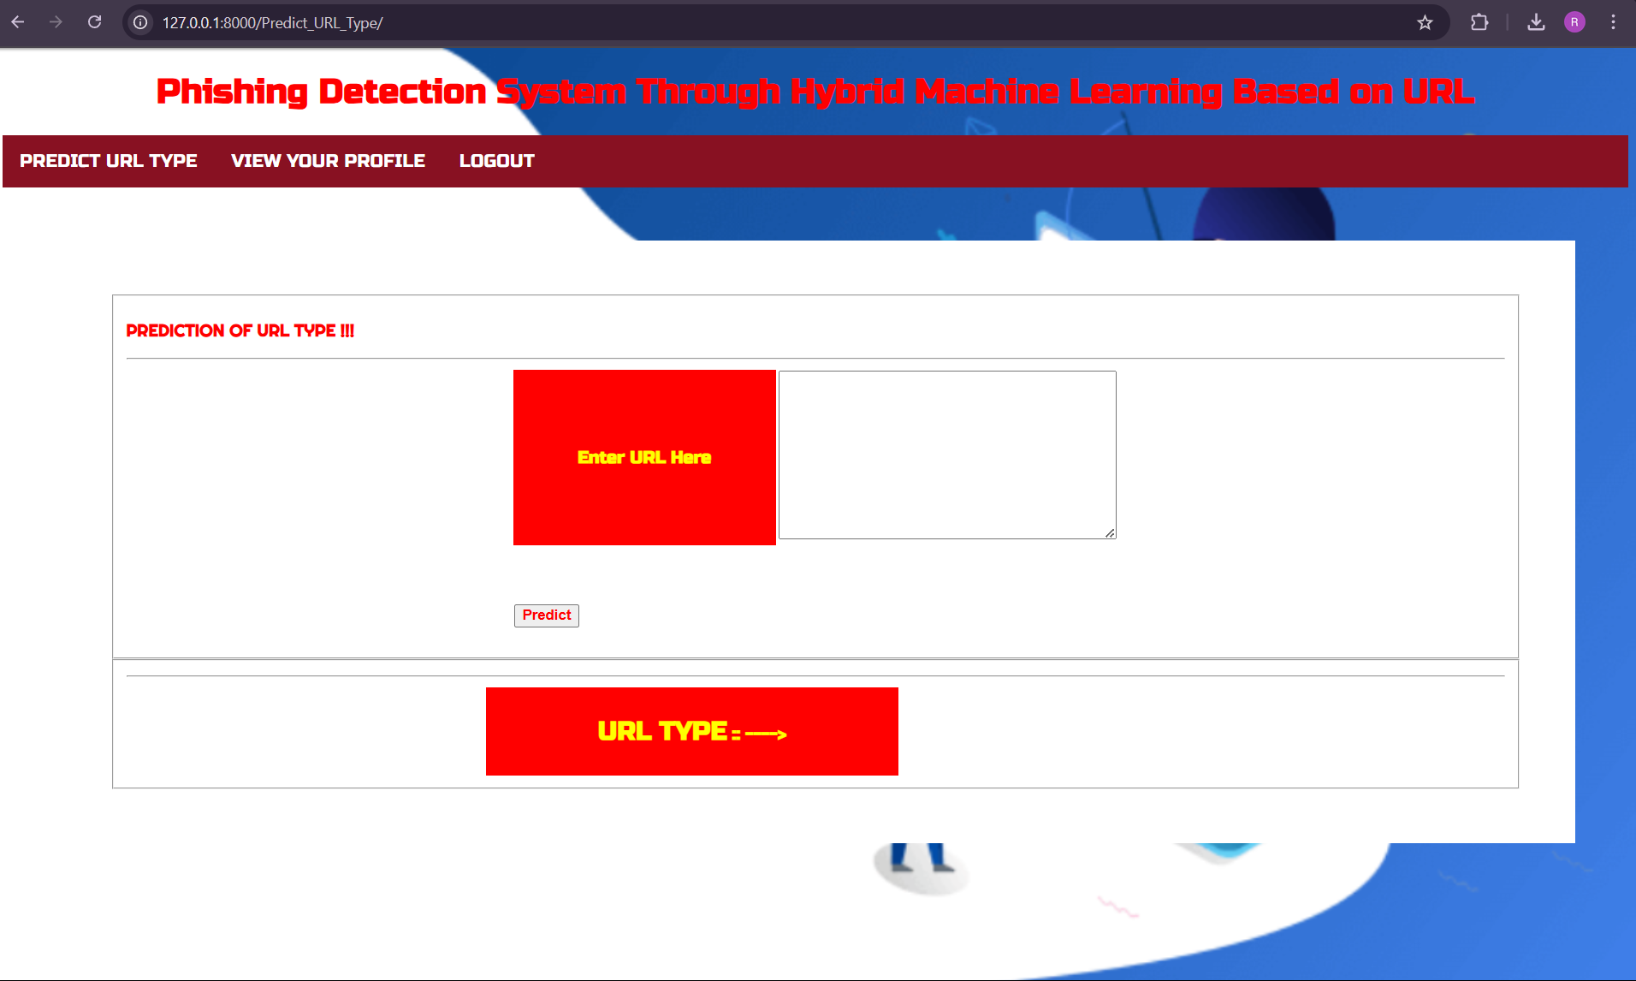
RESULTS

Slide 26
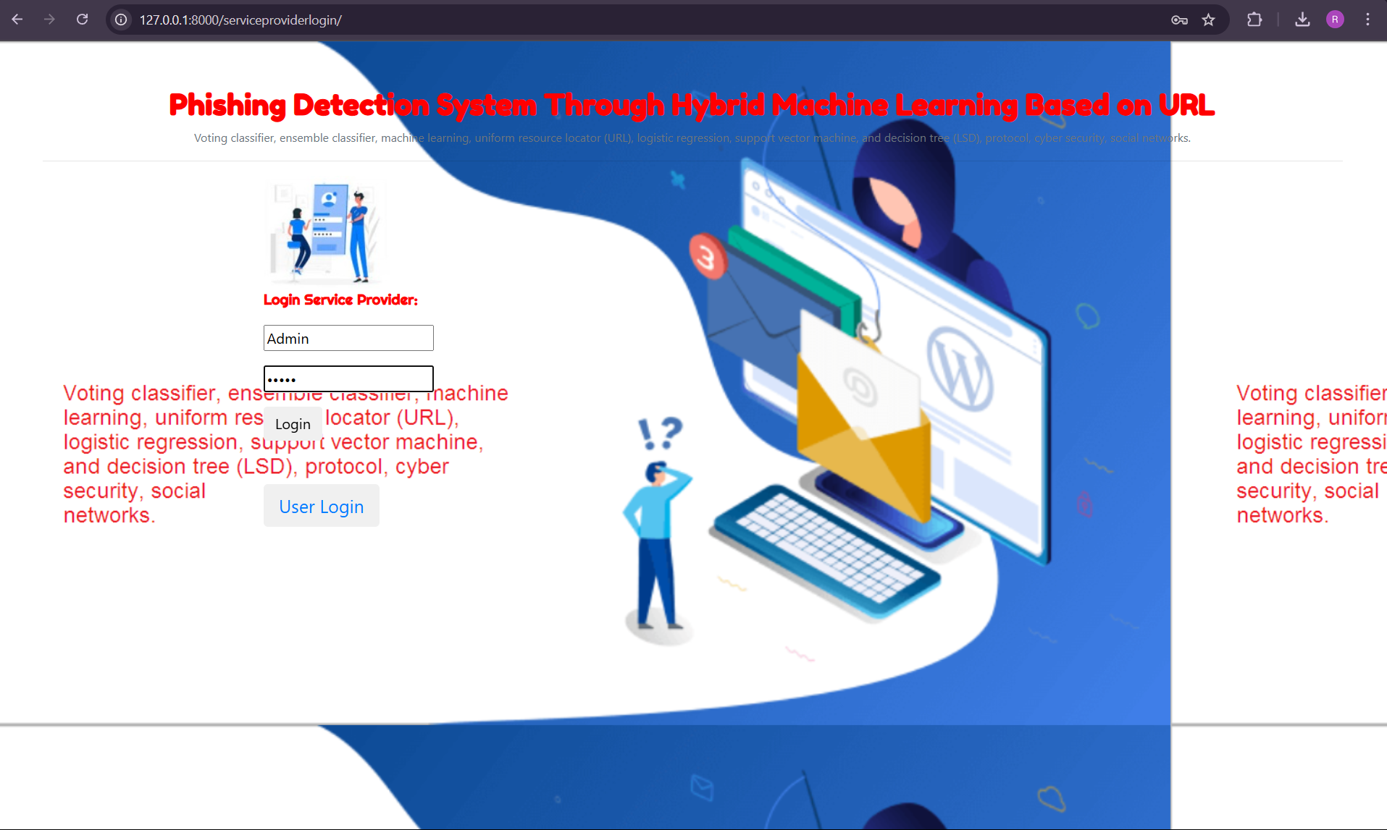
RESULTS

Slide 27
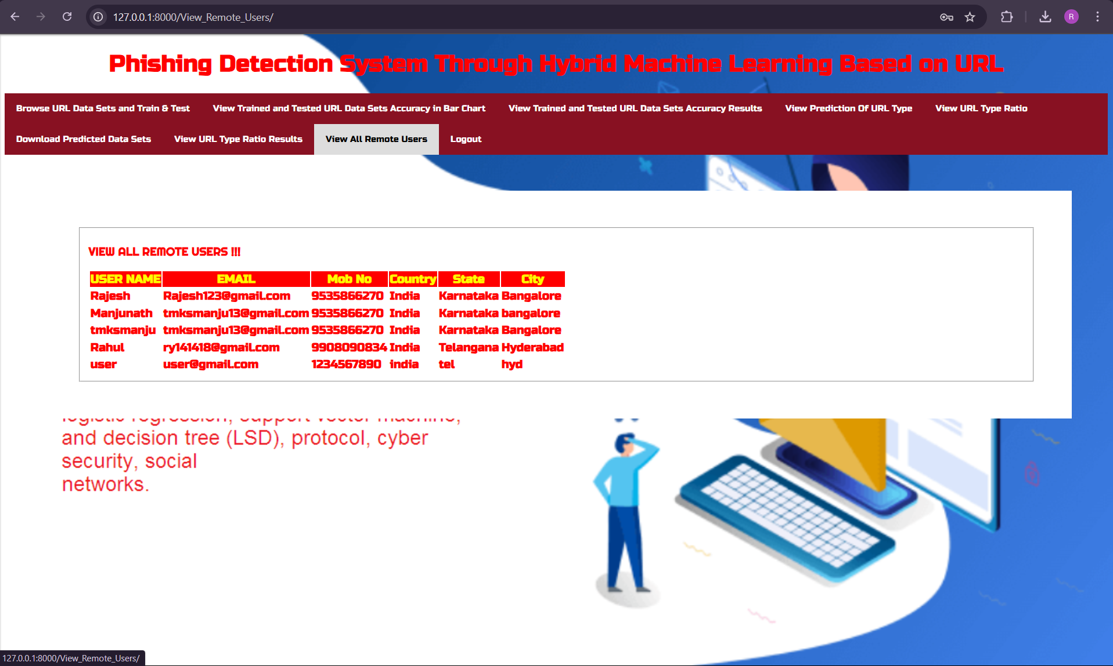
RESULTS

Slide 28
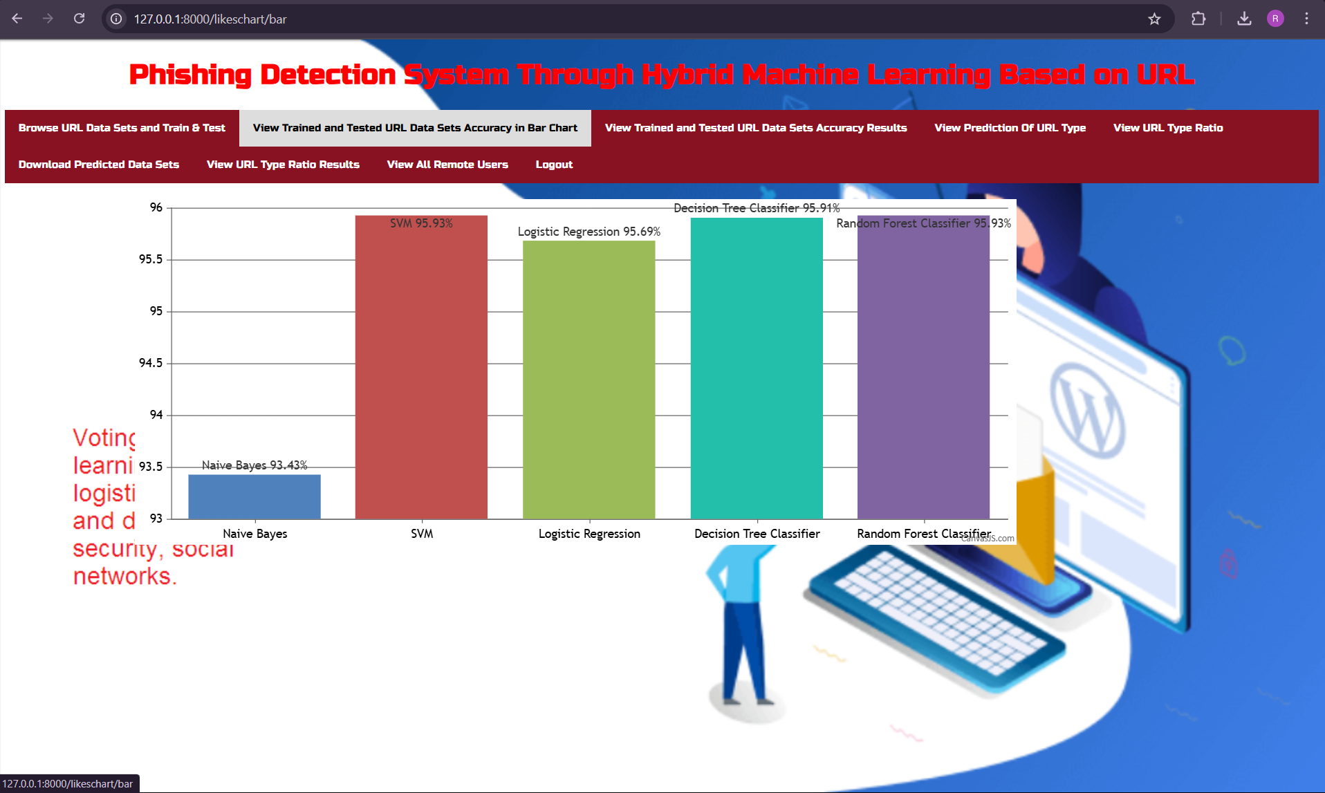
RESULTS

Slide 29
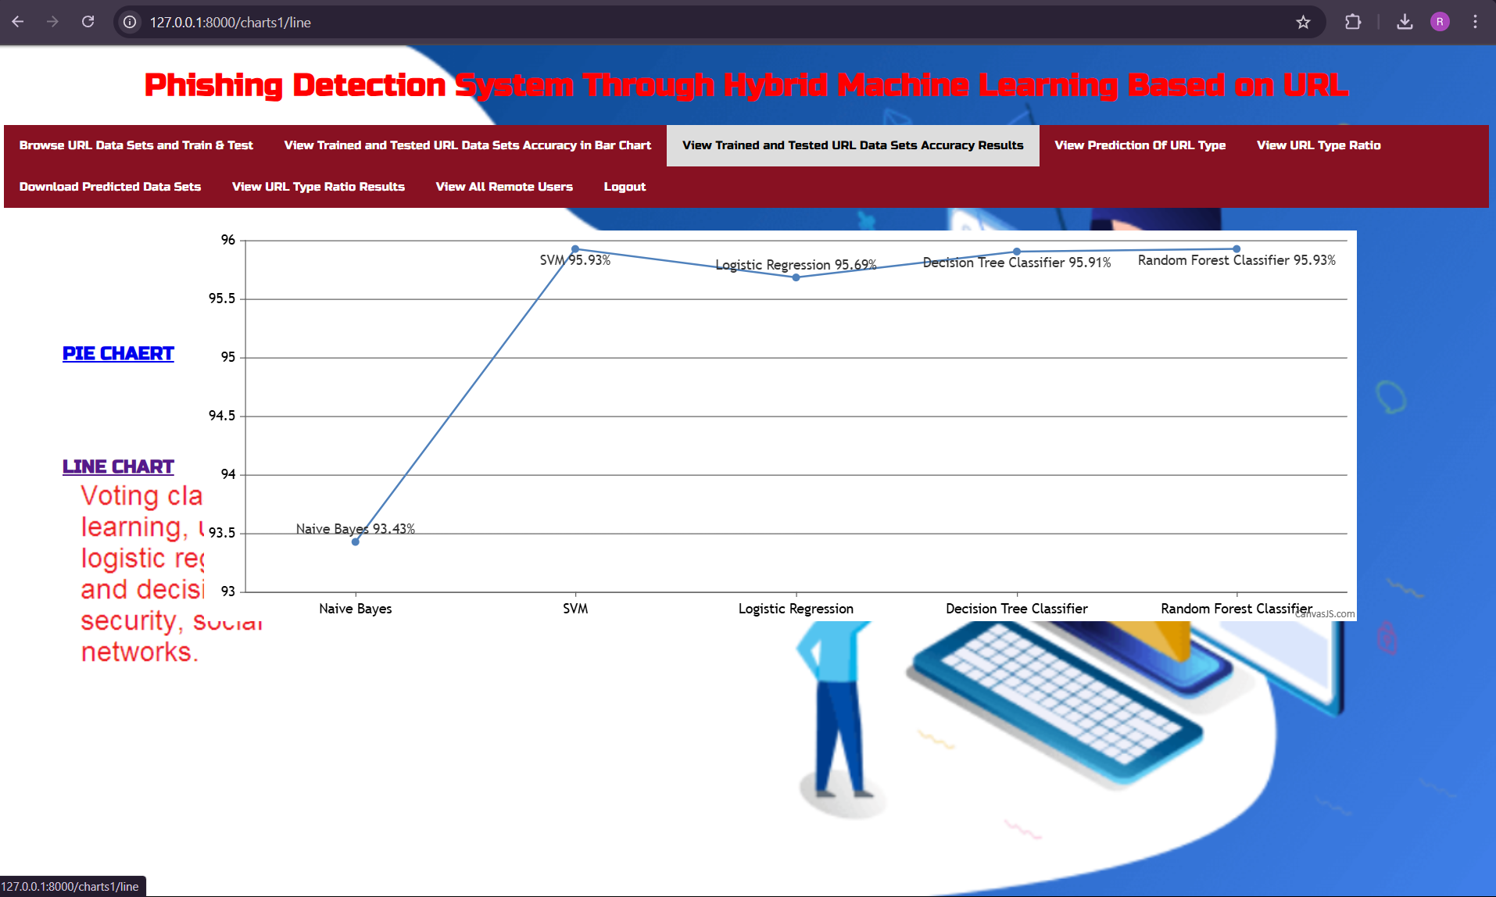
RESULTS

Slide 30
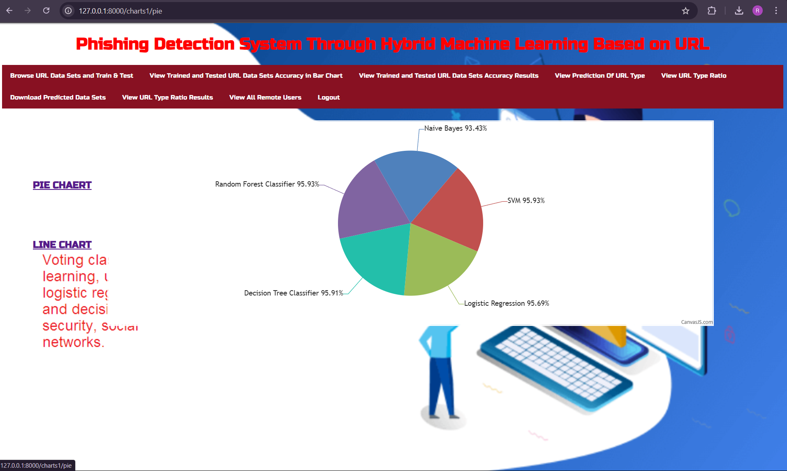
RESULTS

Slide 31
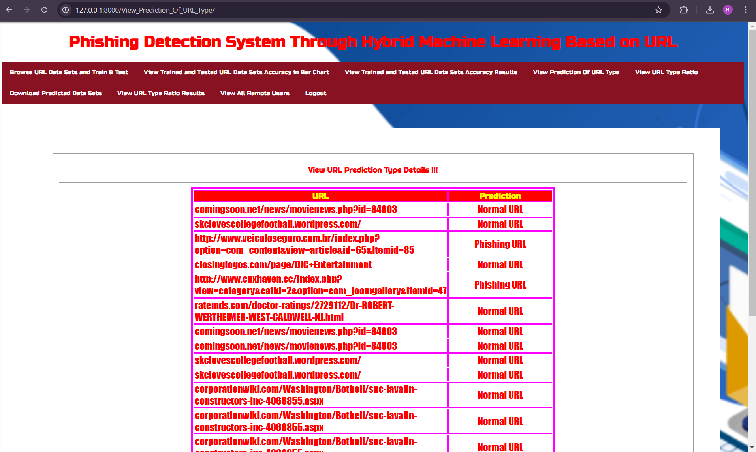
RESULTS

Slide 32
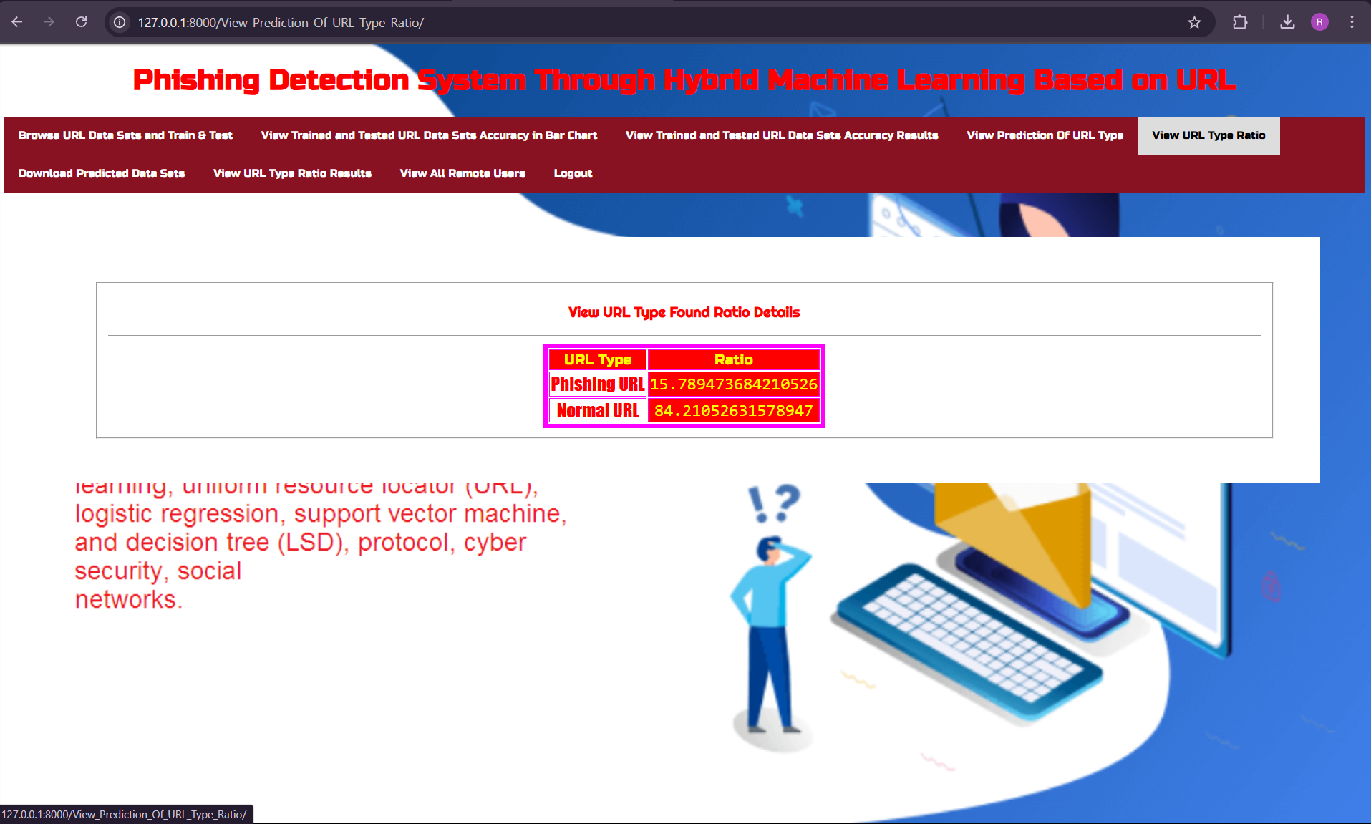
RESULTS

Slide 33
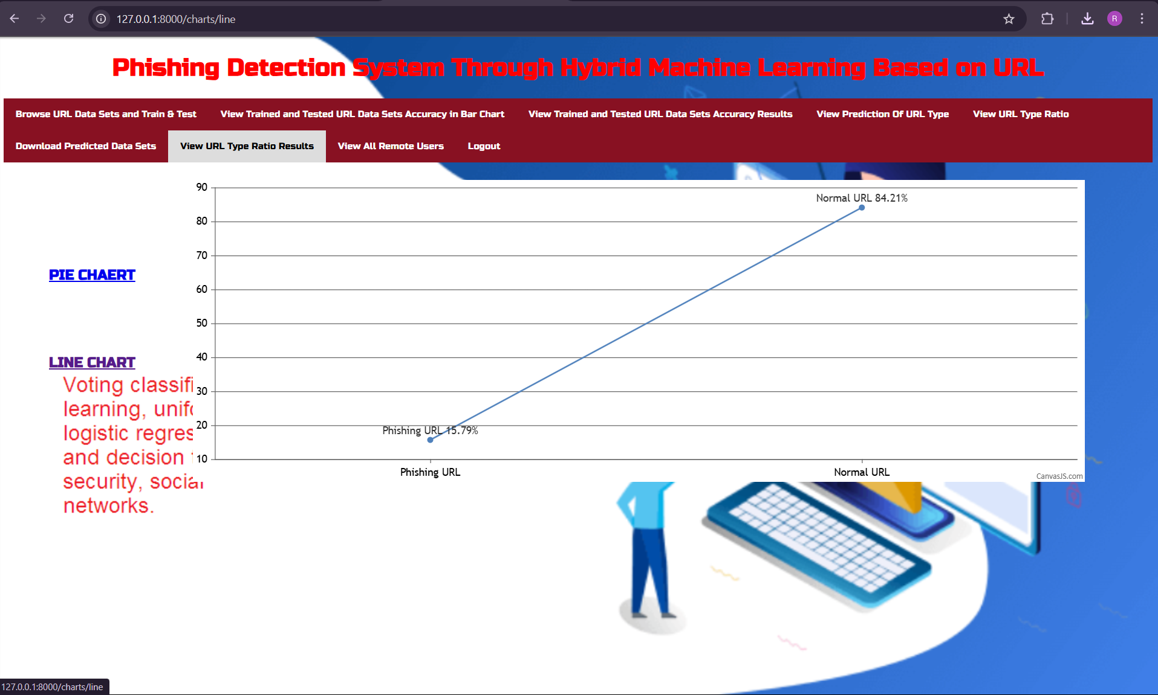
RESULTS

Slide 34
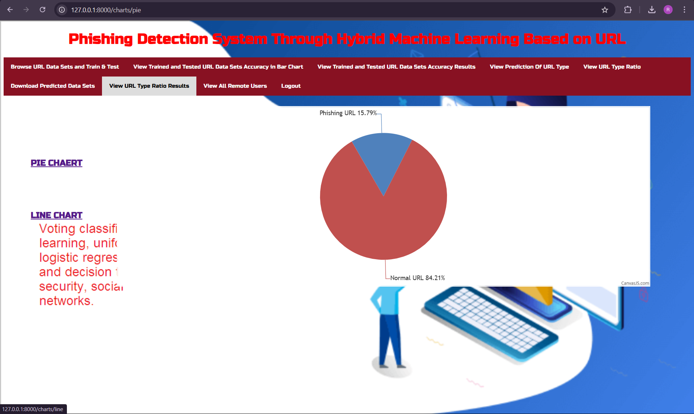
RESULTS

Slide 35
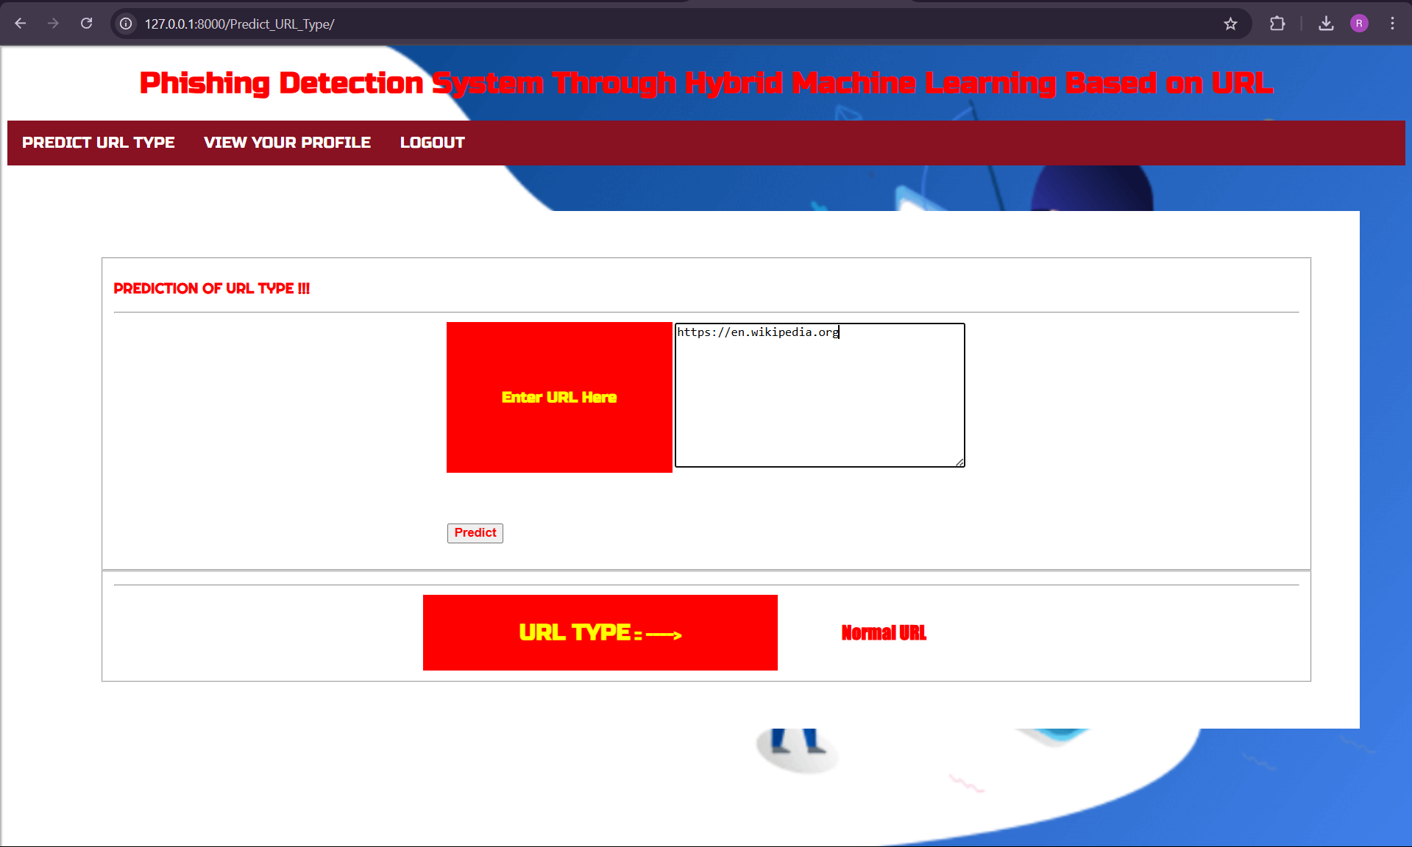
RESULTS

Slide 36
conclusion
This project successfully implemented a hybrid machine learning approach to detect phishing URLs by analyzing key URL attributes. It utilized multiple models, including Decision Tree, Random Forest, Support Vector Classifier, and an LSD-based stacking classifier, significantly improving accuracy and efficiency. The stacking classifier proved to be the most effective, delivering outstanding precision and adaptability to evolving phishing techniques. By integrating multiple machine learning models, the system became more robust and resilient against cyber threats. This solution provides strong protection against phishing attacks, making it a valuable contribution to cybersecurity. Its effectiveness in detecting sophisticated phishing attempts highlights its potential for real-world applications in safeguarding sensitive data and preventing cyber risks.

Slide 37

FUTURE SCOPE
This project will continue to evolve to detect and prevent new phishing threats more effectively. It can be improved by integrating deep learning, analyzing user behavior patterns, and using real-time threat intelligence for better accuracy. Collaboration with cybersecurity experts and industry stakeholders can strengthen the system by making it more adaptable and resilient. Deploying the model in cloud environments and IoT devices will increase its accessibility and usability across different platforms. Regular updates and enhancements will ensure the system remains effective against emerging cyber threats, making it a robust and reliable cybersecurity solution.

Slide 38
REFERENCES
D. M. Divakaran and A. Oest – "Phishing detection leveraging machine learning and deep learning: A review," 2022, arXiv:2205.07411.
A. K. Jain and B. Gupta – "PHISH-SAFE: URL features-based phishing detection system using machine learning," in Cyber Security, Switzerland: Springer, 2018, pp. 467–474.
G. Sonowal and K. S. Kuppusamy – "PhiDMA—A phishing detection model with multi-filter approach," J. King Saud Univ., Comput. Inf. Sci., vol. 32, no. 1, pp. 99–112, Jan. 2020.
M. Zouina and B. Outtaj – "A novel lightweight URL phishing detection system using SVM and similarity index," Hum.-Centric Comput. Inf. Sci., vol. 7, no. 1, p. 17, Jun. 2017.
Y. Cao, W. Han, and Y. Le – "Anti-phishing based on automated individual white-list," in Proc. 4th ACM Workshop Digit. Identity Manage., Oct. 2008, pp. 51–60.
P. Prakash, M. Kumar, R. R. Kompella, and M. Gupta – "PhishNet: Predictive blacklisting to detect phishing attacks," in Proc. IEEE INFOCOM, Mar. 2010, pp. 1–5.

Slide 39
GITHUB LINK
https://github.com/Rahul1418/Phishing-Detection-System-Through-Hybrid-Machine-Learning-Based-on-URL

